Slide 1


Ashwini Dadasaheb Khandave
31/01/2024

Slide 2

Outline
Executive Summary
Introduction
Methodology
Results
Conclusion

Slide 3
Executive Summary
This project aims to predict the successful landing of the Falcon 9 first stage, crucial for estimating launch costs and competitive bidding.
Key Methods:
Data Manipulation and Analysis
Data Collection and Wrangling
Interactive Dashboard Creation
Machine Learning Modeling
Key Results:
Successful data manipulation and analysis provided valuable insights.
Cleaned Falcon 9 landing data enabled accurate analysis.
Developed an intuitive interactive dashboard for launch analysis.
Machine learning models achieved high accuracy in predicting landing success.
Overall, this project aims to optimize rocket launch operations, contributing to more efficient and cost-effective space missions.

Slide 4
Introduction
Project Background:
SpaceX & Falcon 9: SpaceX, led by Elon Musk, is a key player in aerospace, with the Falcon 9 rocket being pivotal in space transport.
First-Stage Landing: Successful first-stage landing of Falcon 9 reduces launch costs significantly, making accurate prediction crucial for cost estimation and competitive bidding.
Key Problems:
Predicting Landing Success: Project focuses on accurately predicting Falcon 9 first-stage landing to improve cost estimation and bidding decisions.
Data-Driven Approach: Utilizing data analysis and machine learning to make informed predictions based on historical launch data.
Operational Optimization: Optimizing rocket launch operations for increased efficiency and cost-effectiveness.

Slide 5

Section 1

Slide 6
Methodology
Executive Summary
Data Collection:
Data collected from various sources, including SpaceX API and web scraping techniques.
Data Wrangling:
Processed data to ensure consistency and accuracy, including handling missing values and formatting issues.
Exploratory Data Analysis (EDA):
Utilized visualization techniques and SQL queries to explore data patterns, trends, and correlations.
Interactive Visual Analytics:
Implemented interactive visual analytics using Folium for geographic analysis and Plotly Dash for dynamic dashboard creation.
Predictive Analysis:
Developed classification models using machine learning techniques.
Model Building and Tuning:
Built and fine-tuned classification models to improve accuracy and performance.

Slide 7
Data Collection
The data sets were collected using various methods:
SpaceX API: A GET request was made to the SpaceX API to retrieve relevant data.
Data Wrangling and Formatting: The response content was decoded as JSON using the .json() function and converted into a pandas DataFrame using .json_normalize().
Data Cleaning: The collected data underwent cleaning processes to address missing values, ensuring data integrity.
Web Scraping: Falcon 9 launch records were extracted from Wikipedia using BeautifulSoup. This involved parsing the HTML table containing launch records and converting it into a pandas DataFrame for further analysis.

Slide 8
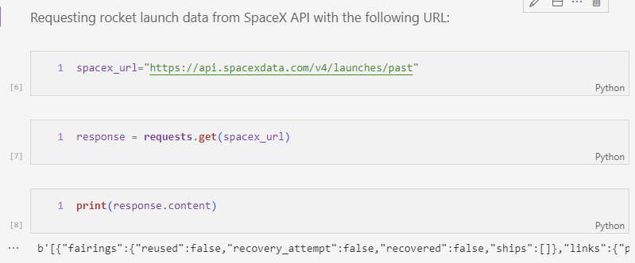
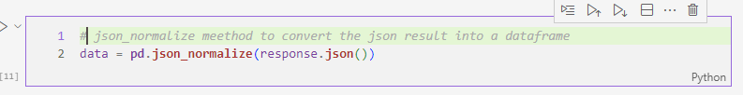
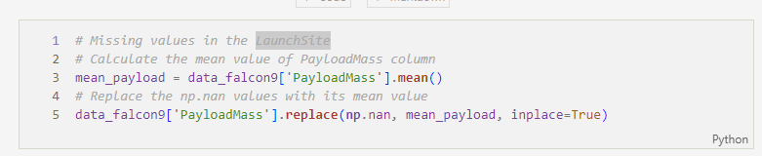
Data Collection – SpaceX API
Utilized a GET request to the SpaceX API for data collection, followed by cleaning and basic data wrangling to ensure data quality and formatting.
Link - https://github.com/AshuKhandave/Machine_Learning_Project/blob/main/jupyter-labs-spacex-data-collection-api.ipynb

Slide 9
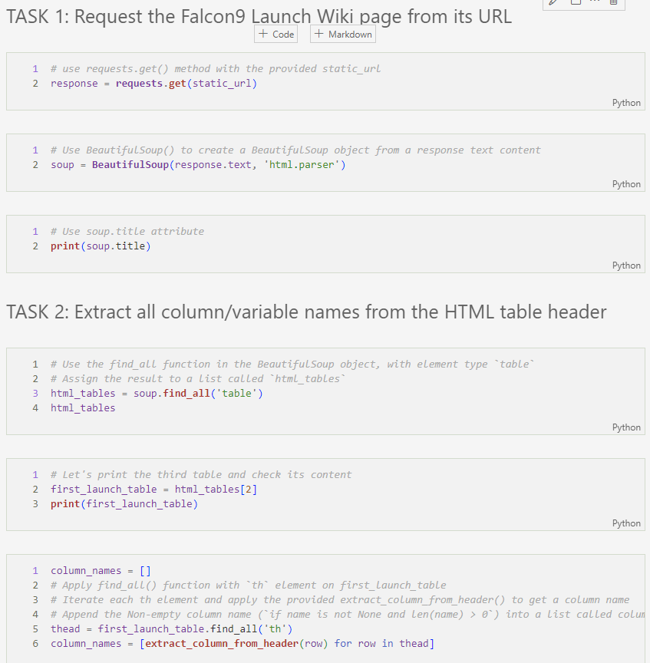
Data Collection - Scraping
Applied web scrapping to webscrap Falcon 9 launch records with BeautifulSoup
Parsed the table and converted it into a pandas dataframe.
Link -https://github.com/AshuKhandave/Machine_Learning_Project/blob/main/jupyter-labs-webscraping.ipynb

Slide 10
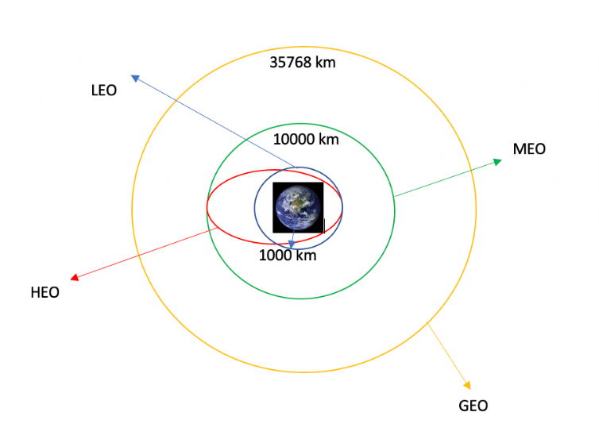
Data Wrangling
Calculated launches per site using value_counts() on LaunchSite.
Counted orbit occurrences with value_counts() on Orbit.
Determined landing outcomes frequency with value_counts() on Outcome.
Created landing_class list: 0 if Outcome in bad_outcome, 1 otherwise.
Link - https://github.com/AshuKhandave/Machine_Learning_Project/blob/main/labs-jupyter-spacex-Data%20wrangling.ipynb

Slide 11
EDA with Data Visualization
We visualized:
Relationship between flight number and launch site
Payload and launch site correlation
Success rate of each orbit type
Flight number and orbit type correlation
Launch success yearly trend
Link -

Slide 12
EDA with SQL
We loaded the SpaceX dataset into a PostgreSQL database directly from the Jupyter notebook.
Then, we performed Exploratory Data Analysis (EDA) with SQL to extract insights from the data. Some of the queries we executed included:
Finding the names of unique launch sites in the space mission.
Calculating the total payload mass carried by boosters launched by NASA (CRS).
Determining the average payload mass carried by booster version F9 v1.1.
Analyzing the total number of successful and failure mission outcomes.
Identifying failed landing outcomes in the drone ship, including their booster version and launch site names.
Link -

Slide 13
Build an Interactive Map with Folium
Utilized Folium for map creation and visualization, pinpointing launch site locations with markers and circles.
Employed MarkerClusters to categorize launch outcomes and MousePosition for real-time coordinate display.
Implemented PolyLines to calculate and depict distances between launch sites and nearby features.
Link -

Slide 14
Build a Dashboard with Plotly Dash
Developed an interactive dashboard using Plotly Dash.
Visualized total launches by specific sites using pie charts.
Examined the relationship between Outcome and Payload Mass (Kg) for various booster versions using scatter graphs.
Link -

Slide 15
Predictive Analysis (Classification)
Following are the steps taken to find the best performing classification model:
1. Data Loading and Transformation: Loaded data with NumPy and Pandas. Transformed and preprocessed the data
2. Data Splitting: Split the data into training and testing sets.
3. Model Building: Developed machine learning models.
4. Hyperparameter Tuning: Used GridSearchCV to tune hyperparameters.
5. Model Evaluation: Evaluated models based on accuracy.
6. Model Improvement: Improved models with feature engineering and tuning.
7. Best Performing Model: Selected the top-performing classification model.
Link -

Slide 16
Results
Exploratory data analysis results
Interactive analytics demo
Predictive analysis results

Slide 17

Section 2

Slide 18
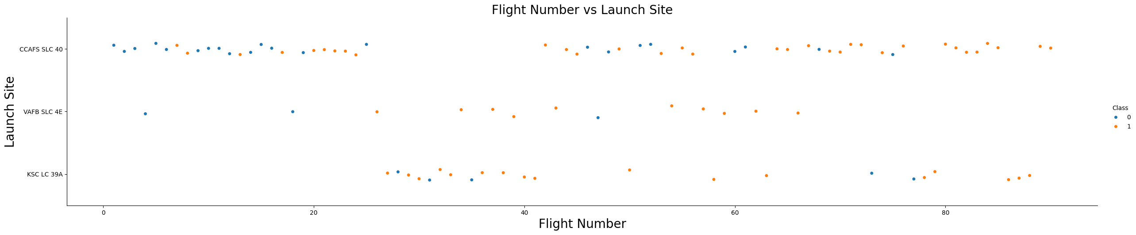
Flight Number vs. Launch Site
The analysis revealed that launch sites with higher flight counts tended to have higher success rates.

Slide 19
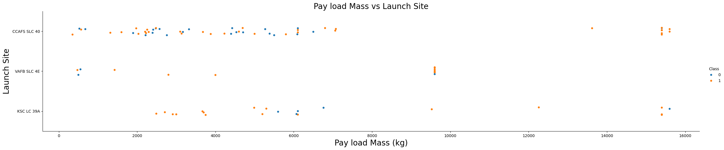
Payload vs. Launch Site
At the VAFB-SLC launch site, there were no rockets launched with a payload mass exceeding 10,000 kg.

Slide 20
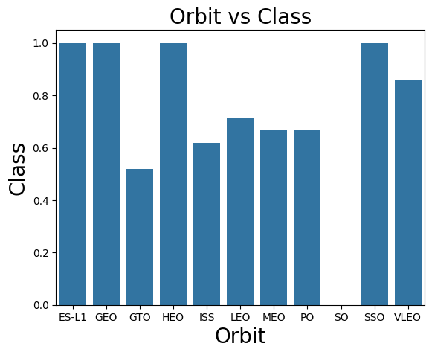
Success Rate vs. Orbit Type
From the plot, we can see that ES-L1, GEO, HEO, SSO, VLEO had the most success rate.

Slide 21
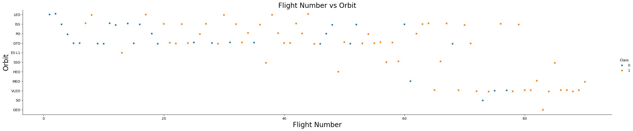
Flight Number vs. Orbit Type
In the LEO orbit, success appears to be related to the number of flights, whereas in the GTO orbit, there seems to be no relationship between flight number and success.

Slide 22
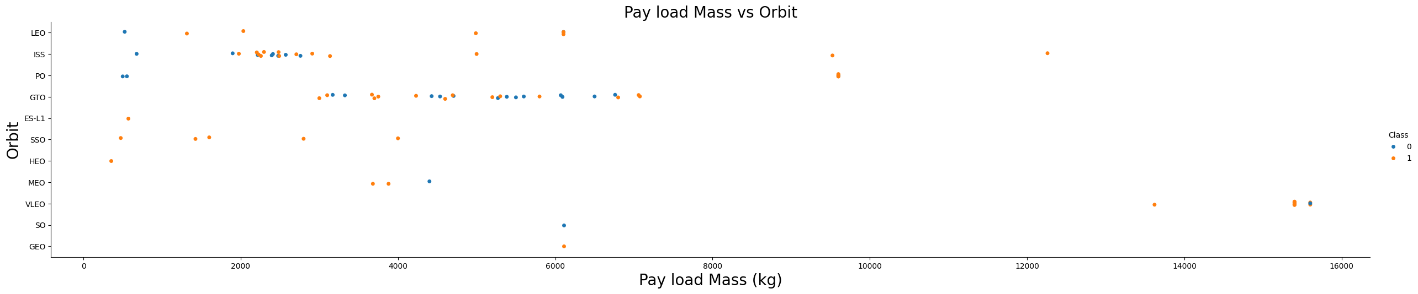
Payload vs. Orbit Type
We can observe that with heavy payloads, the successful landing are more for PO, LEO and ISS orbits.

Slide 23
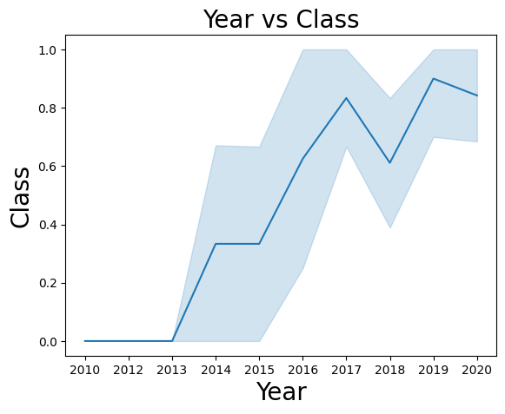
Launch Success Yearly Trend
From the plot, we can observe that success rate since 2013 kept on increasing till 2020.

Slide 24
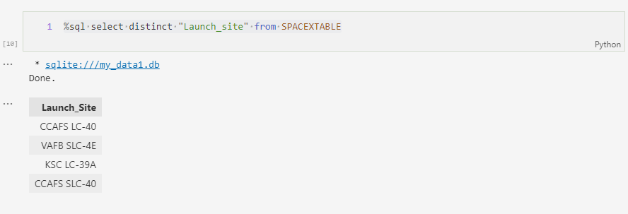
All Launch Site Names
Used the DISTINCT keyword in SQL to display unique launch sites from the SpaceX data.

Slide 25
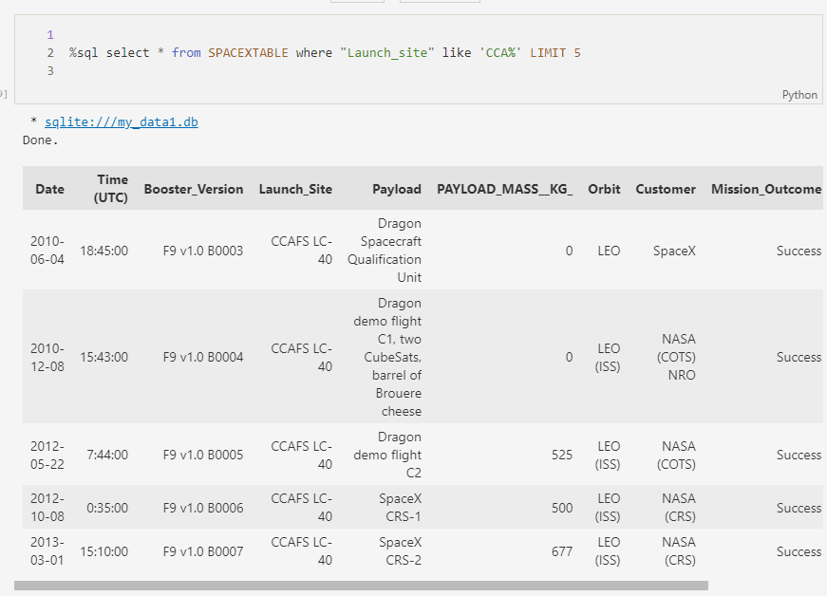
Launch Site Names Begin with 'CCA'
Used the query above to display 5 records where launch sites begin with `CCA`

Slide 26
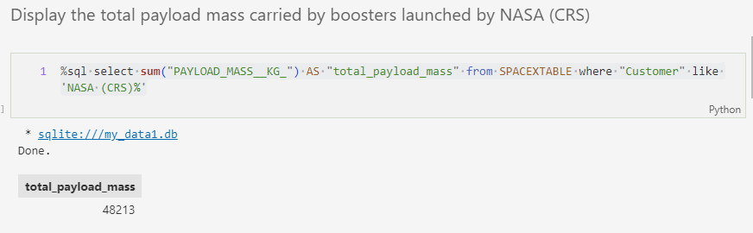
Total Payload Mass
We calculated the total payload carried by boosters from NASA as 48213 using the query below:

Slide 27
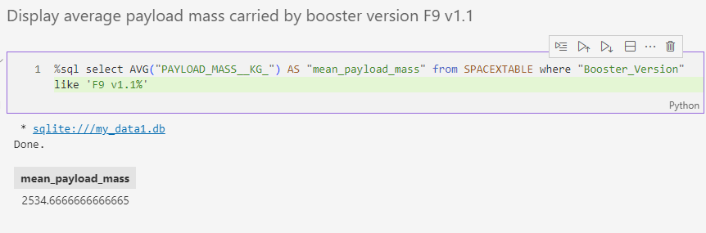
Average Payload Mass by F9 v1.1
The average payload mass carried by booster version F9 v1.1 as 2534.66.

Slide 28
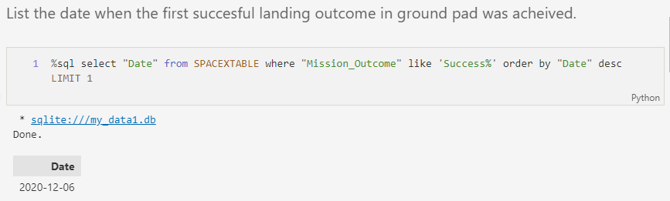
First Successful Ground Landing Date
Observed that the dates of the first successful landing outcome on ground pad was 6th December 2015.

Slide 29
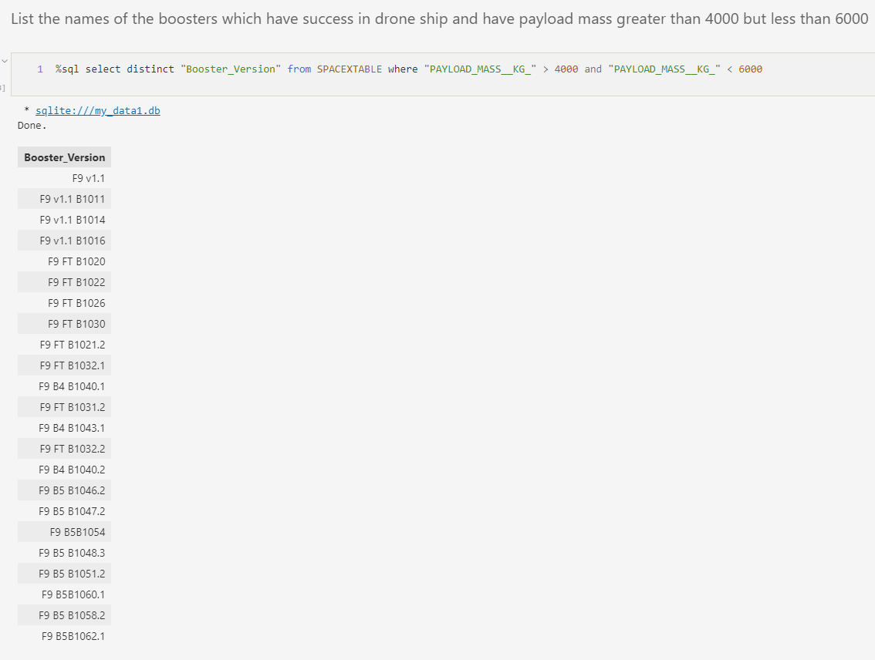
Successful Drone Ship Landing with Payload between 4000 and 6000
Applied the WHERE clause to filter boosters that successfully landed on a drone ship.
Used the AND condition to determine successful landings with payload mass greater than 4000 but less than 6000.

Slide 30
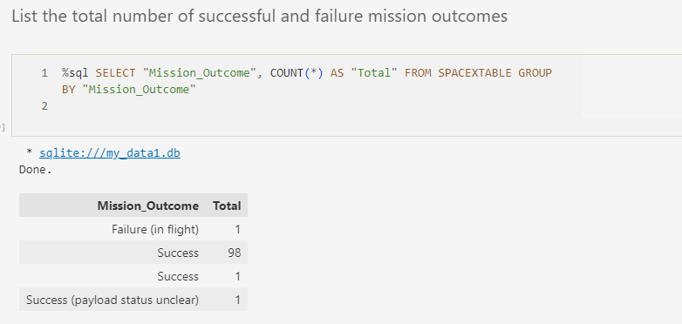
Total Number of Successful and Failure Mission Outcomes
Retrieved the total number of successful and failed mission outcomes using SQL.

Slide 31
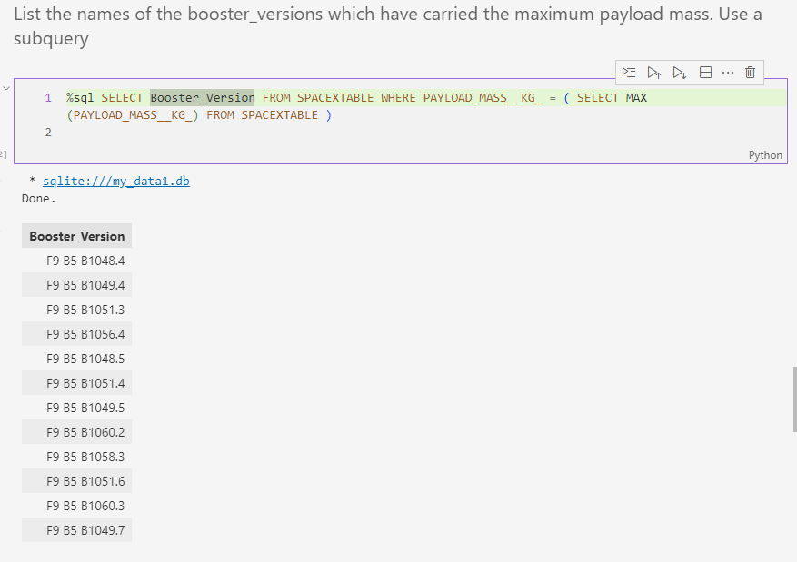
Boosters Carried Maximum Payload
Used a subquery within the WHERE clause to retrieve the booster version with the highest

Slide 32
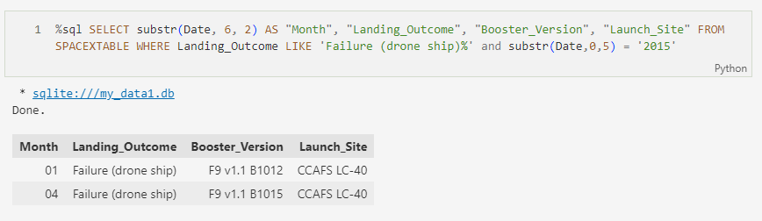
2015 Launch Records
Used a subquery within the WHERE clause to filter the data based on a specific condition. In this case, I retrieved the month, landing outcome, booster version, and launch site from the SPACEXTABLE where the landing outcome was specified as "Failure (drone ship)" and the year was 2015.

Slide 33
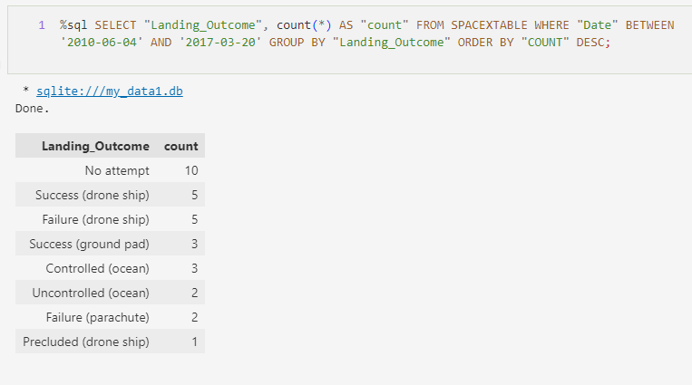
Rank Landing Outcomes Between 2010-06-04 and 2017-03-20
This SQL query retrieves the count of different landing outcomes from the SPACEXTABLE between the dates '2010-06-04' and '2017-03-20'. The results are grouped by the landing outcome and sorted in descending order based on the count.

Slide 34

Section 3

Slide 35
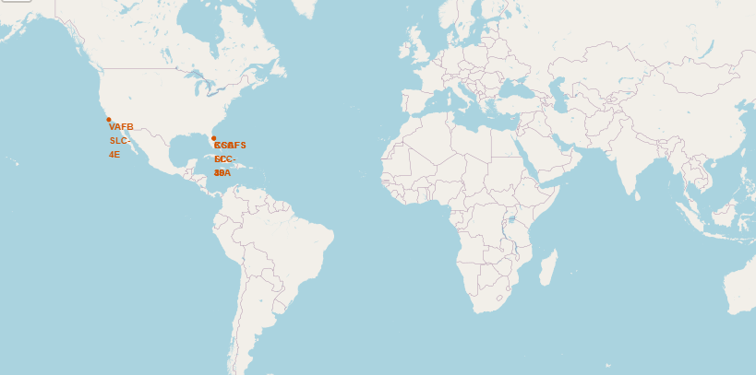
All Launch Sites Global Map Markers
From the map we can see that the SpaceX launch sites are in the USA coasts, Florida and California.

Slide 36
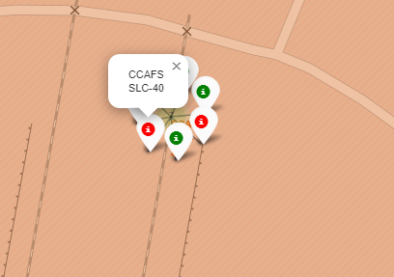
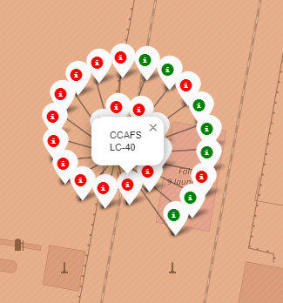
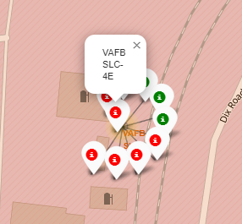
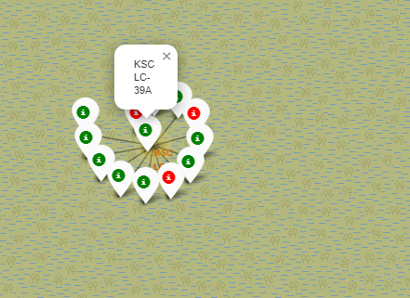
Launch Sites with Colored Markers
California Launch Sites
Florida Launch Sites
Green Marker shows successful Launches and Red Marker shows failures.

Slide 37

Launch Site Distance to Landmarks

Slide 38

Section 4

Slide 39
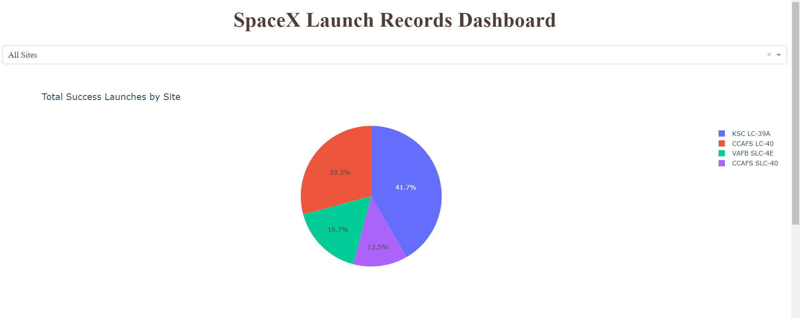
Success Percentage Achieved by each Launch Site
KSC LC-39A had the most successful launches amongst all the sites.

Slide 40
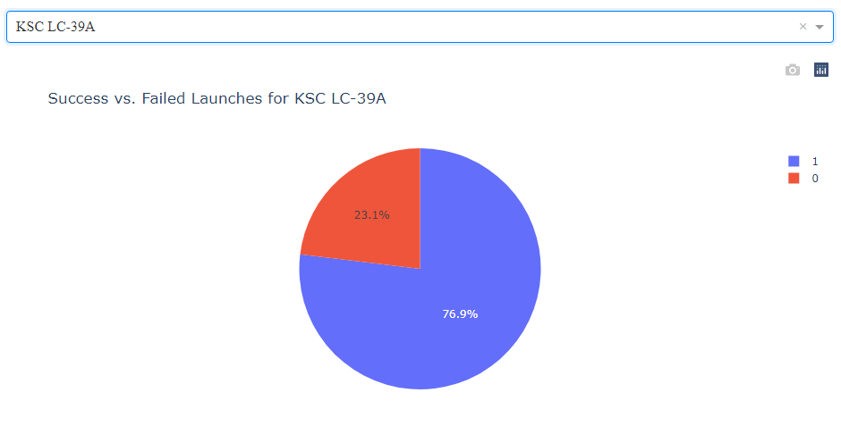
Launch Site with the Highest Launch Success Ratio

Slide 41
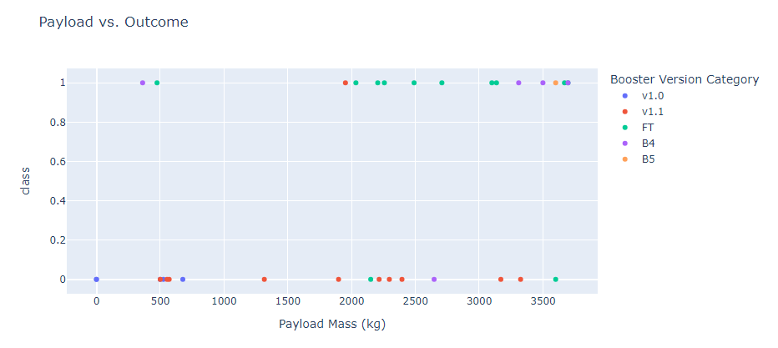
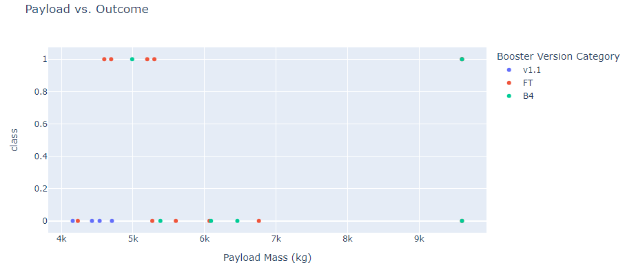
<Dashboard Screenshot 3>
Low Payload (0kg - 4000kg)
High Payload (4000kg – 10000kg)
The success rate is higher for low weighted payloads than high weighted payload.

Slide 42

Section 5

Slide 43
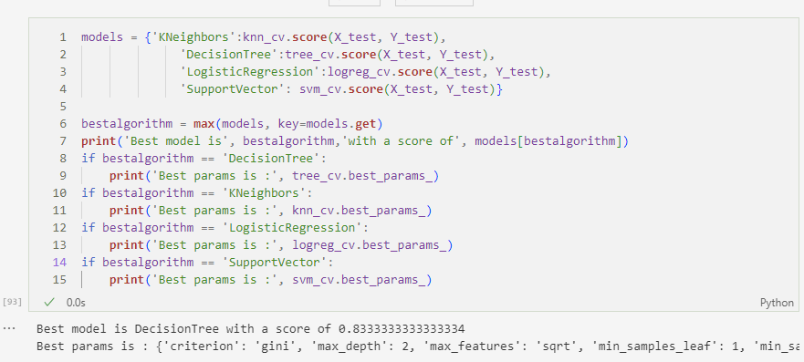
Classification Accuracy
Decision tree performs the best amongst all the models with an accuracy of 83.33%.

Slide 44
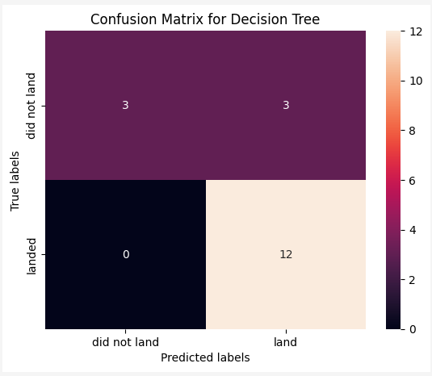
Confusion Matrix
The confusion matrix for the decision tree classifier shows that the classifier can distinguish between the different classes. The major problem is the false positives .i.e., unsuccessful landing marked as successful landing by the classifier.

Slide 45
Conclusions
Summary of Conclusions:
Higher flight numbers at a launch site correlate with higher success rates.
Launch success rates have shown an increasing trend from 2013 to 2020.
Orbits ES-L1, GEO, HEO, SSO, and VLEO exhibit the highest success rates.
KSC LC-39A stands out with the highest number of successful launches among all sites.
The Decision Tree Classifier emerges as the optimal machine learning algorithm for this analysis.

Slide 46


